Slide 1


Flutter & Unity
When a UI framework meets a game engine
Lorant Csonka

Slide 2

Agenda
Mobile platforms and frameworks
Flutter & Unity 3D
Fusion – new possibilities!
Demo
Q&A

Slide 3
Mobile platforms and frameworks
Choose wisely
Code
Cost
Platform
Performance

Slide 4
Mobile platforms and frameworks
Choose wisely
Code
Cost
Platform
Performance
Cross-platform

Slide 5
Mobile platforms and frameworks
Choose wisely
Code
Cost
Platform
Performance
Cross-platform
It’s not cheap enough.

Slide 6
Mobile platforms and frameworks
Choose wisely
Code
Cost
Platform
Performance
Cross-platform
It’s not compatible enough.

Slide 7
Mobile platforms and frameworks
Choose wisely
Code
Cost
Platform
Performance
Cross-platform
It’s not fast enough.

Slide 8
Mobile platforms and frameworks
Choose wisely
Code
Cost
Platform
Performance
Cross-platform
It’s not ……… enough. - Or is it?

Slide 9
Mobile platforms and frameworks
Choose wisely
Code
Cost
Platform
Performance
Cross-platform
It’s not ……… enough. - Or is it?
Narrow the target and compromise

Slide 10
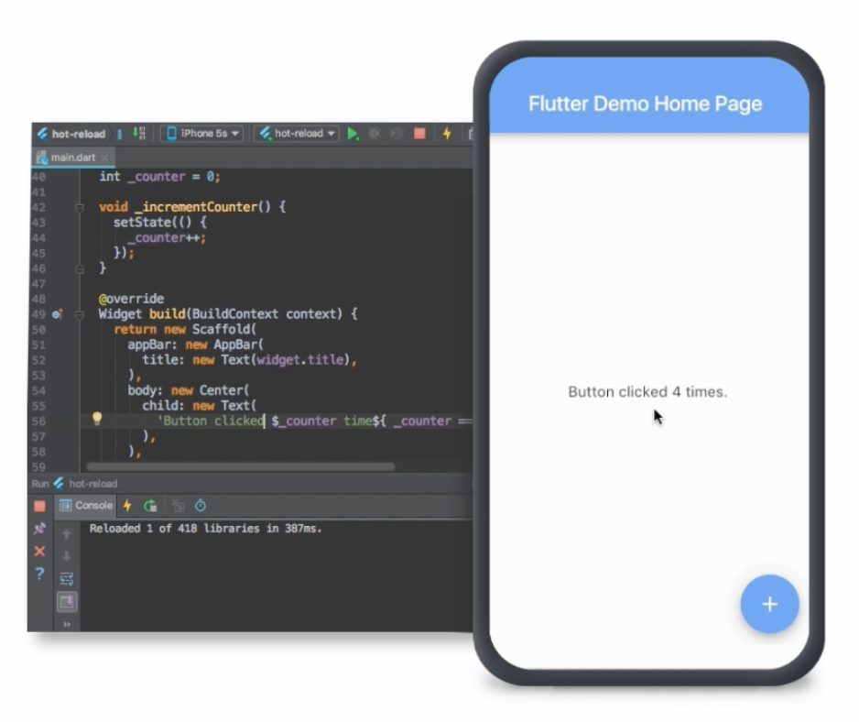
Flutter
Introduced in 2015, stable version in 2018 December
Based on Dart
OO, managed programming language by Google
Compile to JavaScript or Native
Rendering with Skia (C++ 2D Graphics Engine)
Composed of (open-source) widgets

Slide 11
Flutter
Easy to design, nice UI
Hot-reload
Built-in Material Design and Cupertino widgets
Fast development
Works well with Google’s ecosystem
Very easy to debug
Testing is encouraged

Slide 12
What if a client requests an app which is…
Super fast
Super nice
Cheap
Cross-platform
Basically 2D

Slide 13
What if a client requests an app which is…
Super fast
Super nice
Cheap
Cross-platform
Basically 2D
But there is some heavy 3D stuff included…

Slide 14
Unity 3D
One of the most popular game engine
Cross platform
Mobile, Desktop, Console, VR, AR
C# based
Professional? …about a year ago.
Scriptable, testable, white box
Export binaries as components/modules
Architecture, Engineering, Movies, etc.

Slide 15
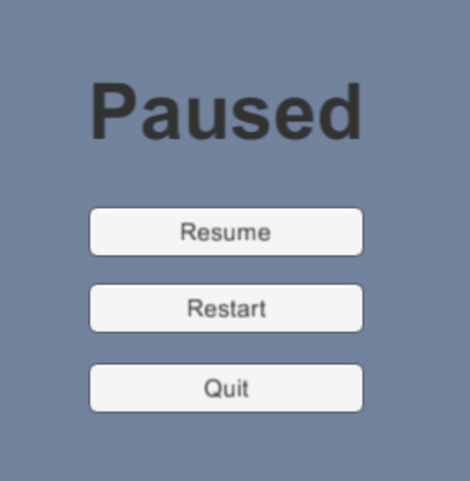
Back to the request..
Can we do a 2D design with Unity?
Yes, if it’s a platform game
No, if it’s UI.

Slide 16
Back to the request..
Can we do a 2D design with Unity?
Yes, if it’s a platform game
No, if it’s UI.
What now?
React & three.js?
Native apps?
Business app UI with Unity?

Slide 17
Fusion – new possibilities!
PlatformView (Flutter widget)
Embed native views in the widget hierarchy
Unity can now export binaries (not just build an app)
Let’s combine them!
flutter-unity-view-widget
Unity 3D widget inside a flutter app
Power? Provided by the Unity framework
Communication? Message call-backs (implemented for both platform)

Slide 18
Customer request…
Let’s just combine what we know
Super fast …OK!
Super nice …OK!
Cheap …OK!
Cross-platform …OK!
Basically 2D …OK! - so far so good!

Slide 19
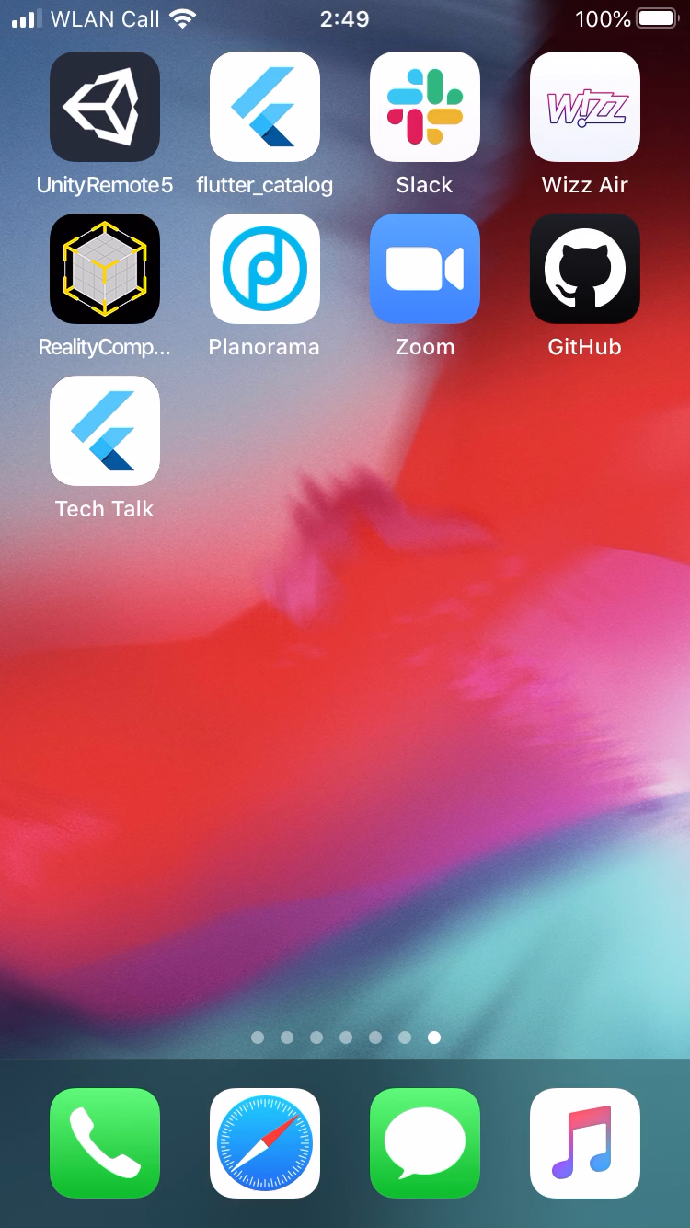
Customer request…
Let’s just combine what we know
Super fast …OK!
Super nice …OK!
Cheap …OK!
Cross-platform …OK!
Basically 2D …OK! - so far so good!
But there is some heavy 3D stuff included …OK!

Slide 20
Q&A

